Slide 1
Integrating Building-Level and Campus-Level Data
Lan Wei
Department of Computer Science
University of British Columbia
Oct 15, 2013
Supervisor: Prof. Rachel Pottinger

Slide 2
A Case Scenario
Consider a case scenario: someone made a request for maintenance to look at the temperature in “core chem Physics office A249”, since it was too cold (14 degrees).
Solution:
Locating the particular building and room in the work request.
Checking the heating and cooling systems that serve that particular area or room.
Looking at information about the manufacturer, serial number, maintenance history information, service manual, and spare part information about the specific equipment.
Checking the buildings and rooms which will be affected when fixing this system.
Notes:
I will start my presentation from the motivation

Slide 3
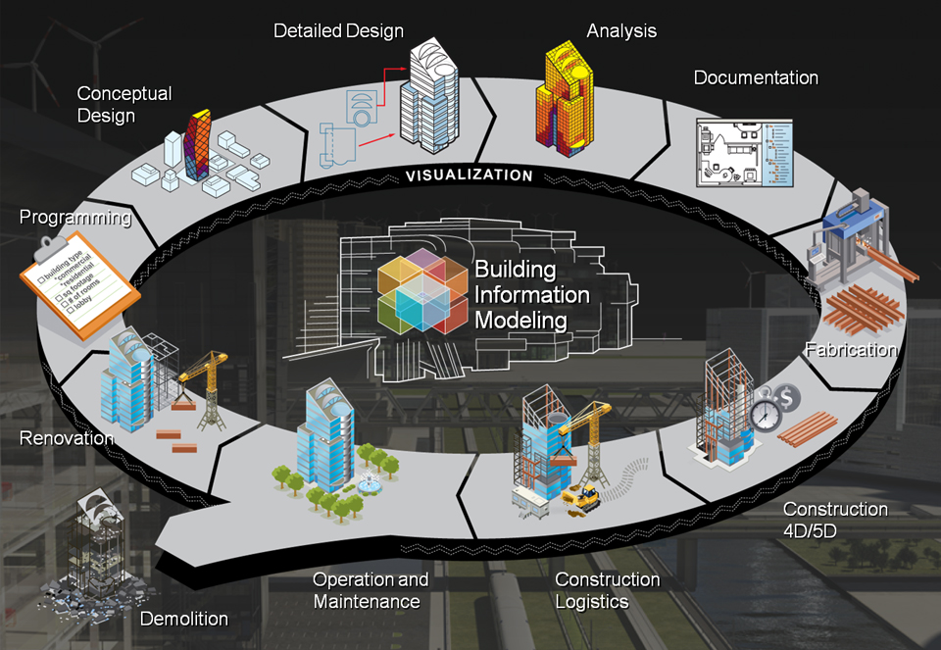
A Building’s Life Cycle

Slide 4
Motivation
Decision-making System
Construction Managers
Engineers
Architects
Building Operations
Designers
Stakeholders
…
Decision making benefits the facility management, inspection, and maintenance operations, also the city planning and energy control.
Notes:
A building has been through plan, design, construction, maintenance, which involves people from … to …

Slide 5
Solution -- Integration
Facility information created throughout all project phases and from many different disciplines with different systems and at different levels of detail in different formats.
Integration different models across scales provides a platform for many people from different discipline incorporating together.
Integration provides more high quality, accurate and rich building information and supports more efficient, low-cost building operations.
Integrating facility information and maintenance history together facilitates building facility management and maintenance operations.
Notes:
In order to solve the requests, we need to integrate building data across phase and scales

Slide 6
Problem
The data are varied in different representations and schemas, and the current applications is not able to support the visualization of the integrated data.
Notes:
Integration is difficult because BIMs and 3D city models vary in both semantic and geometric representations.

Slide 7
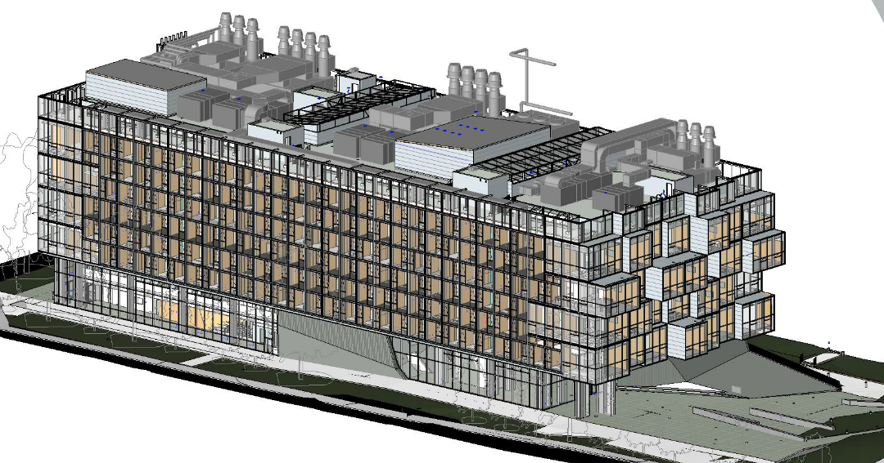
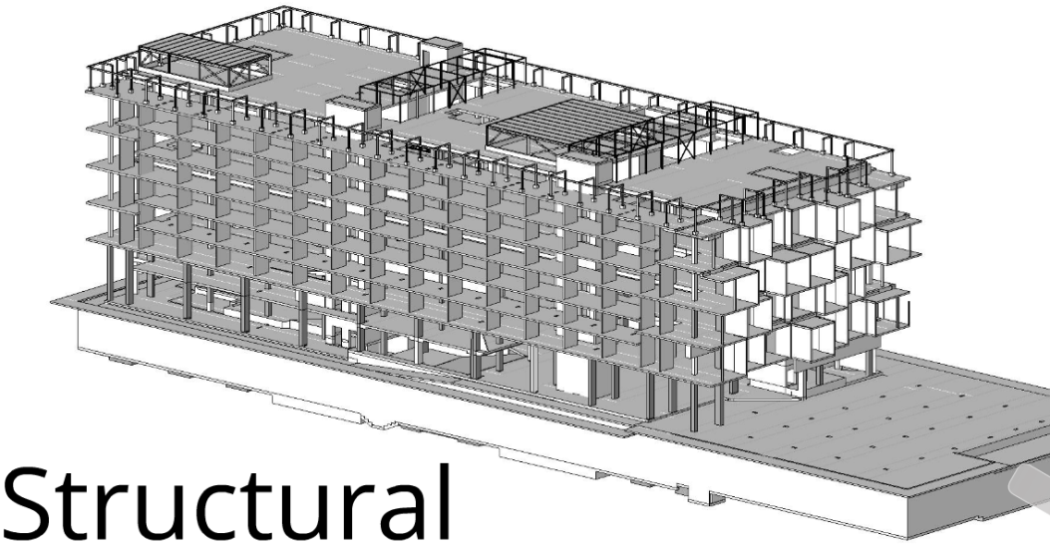
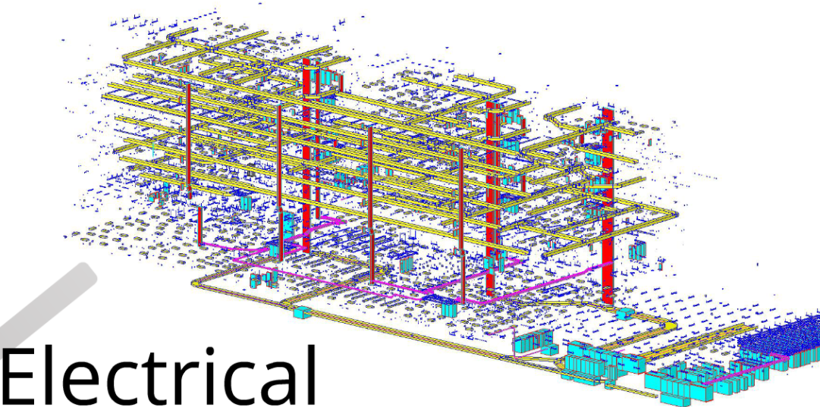
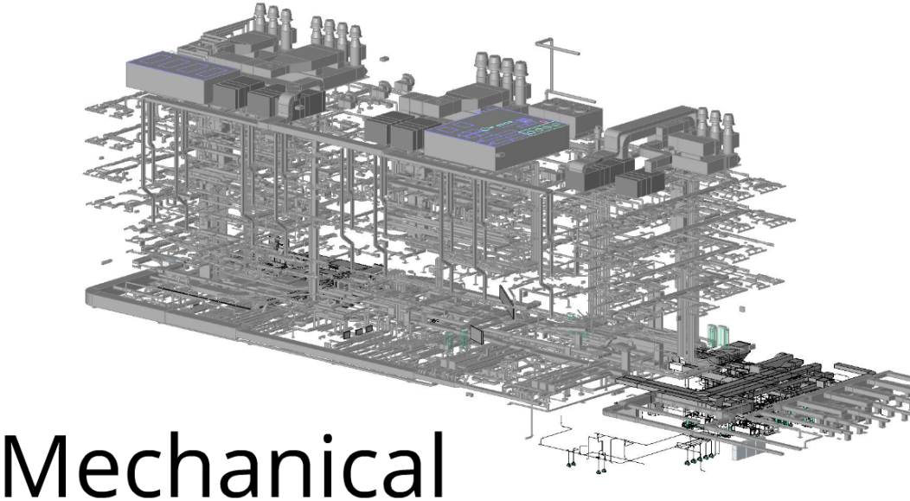
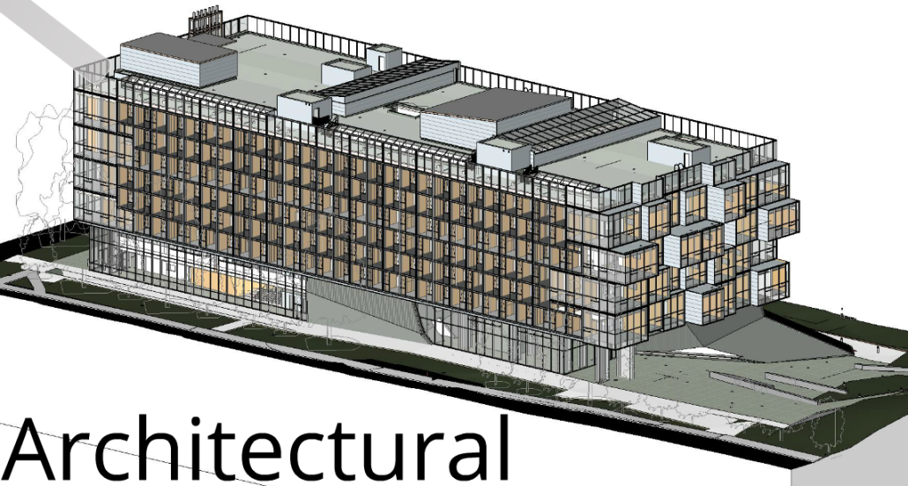
Building-level Data

Slide 8
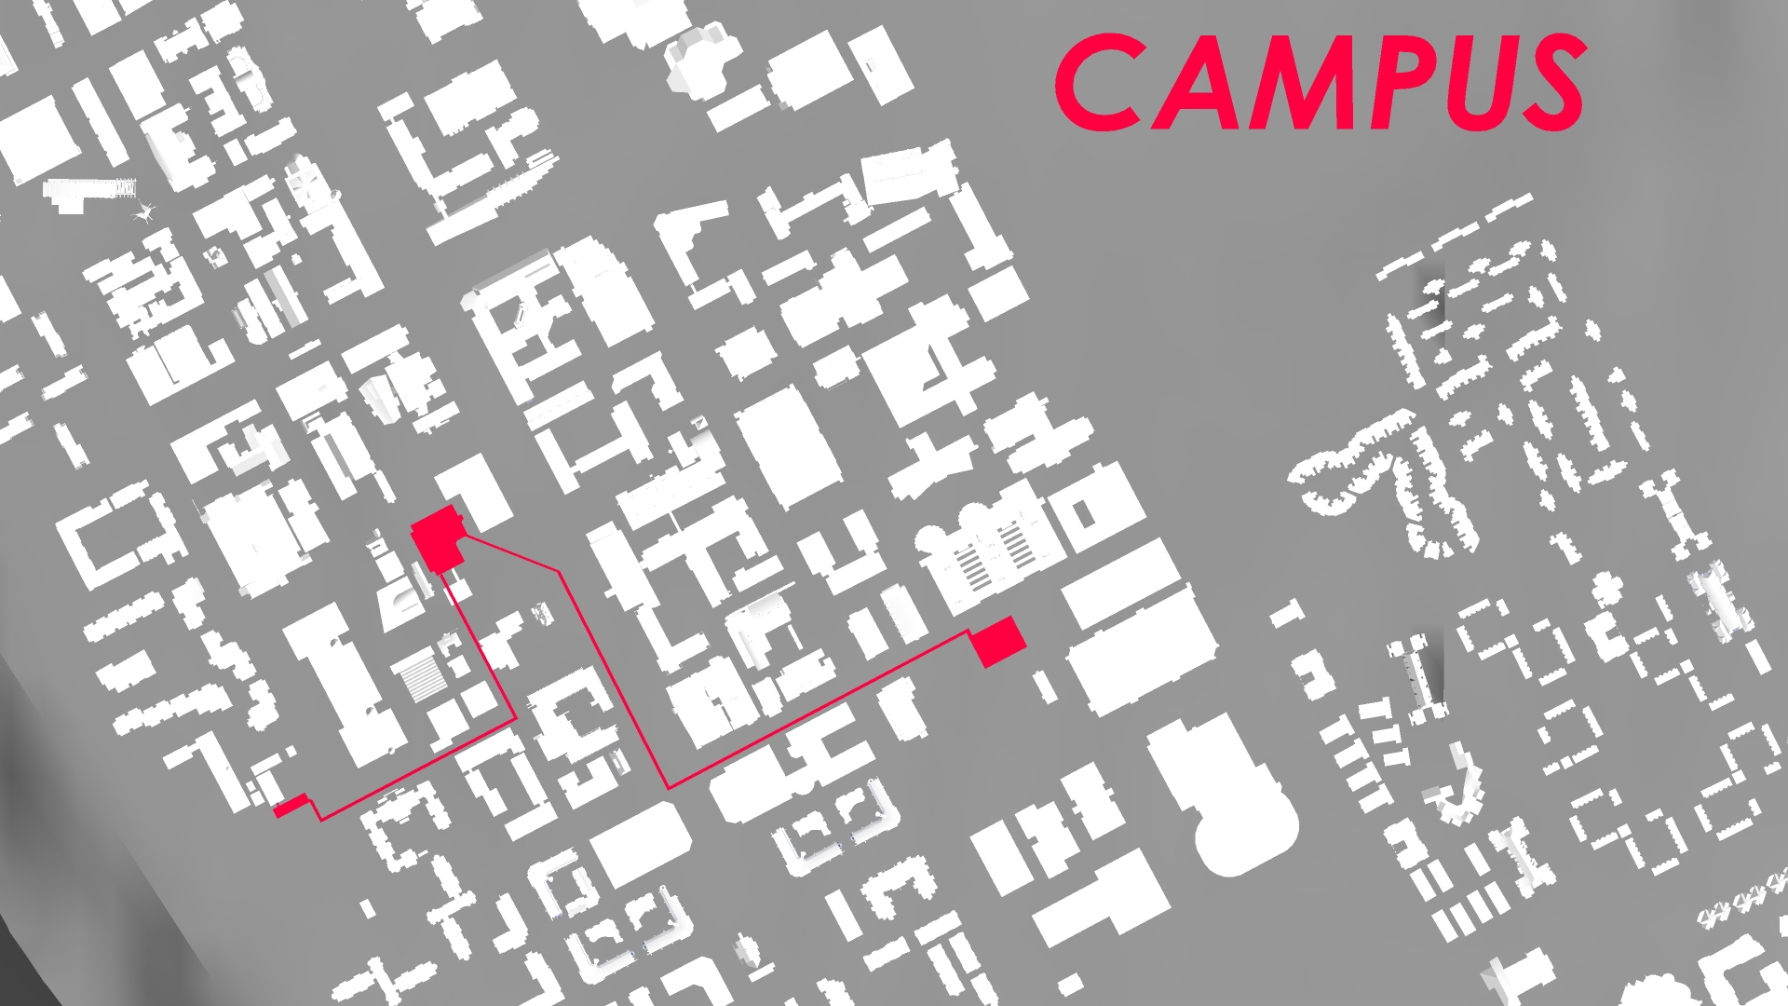
Campus-level Data

Slide 9
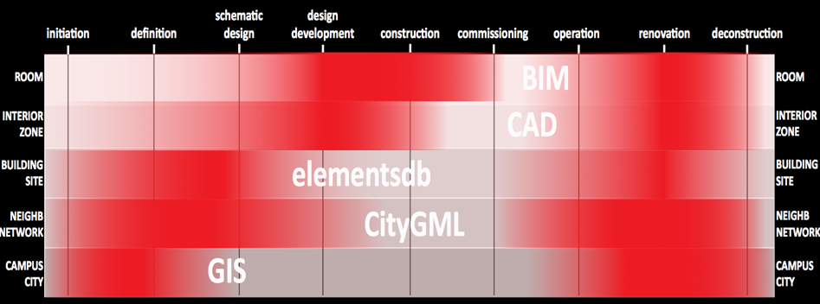
Integrating Across Building Scale and phase

Slide 10
IFC and CityGML
There are many different building information models and 3D geospatial information models representing real world surrounding objects from both geometrical and semantic perspectives.
Industry Foundation Classes (IFC) and City Geography Markup Language (CityGML) are two of the most prominent semantic models.
IFC describes buildings with respect to their geometric and semantic properties. It defines building components as elements and their properties and the relationships between them, and it comprises information of a building’s whole lifecycle.
CityGML is a common information model for the representation, storage, and exchange of virtual 3D city and landscape models. It represents geospatial environment as well as the building components. IFC only has the detailed building information, excluding the outer surrounding environment.

Slide 11
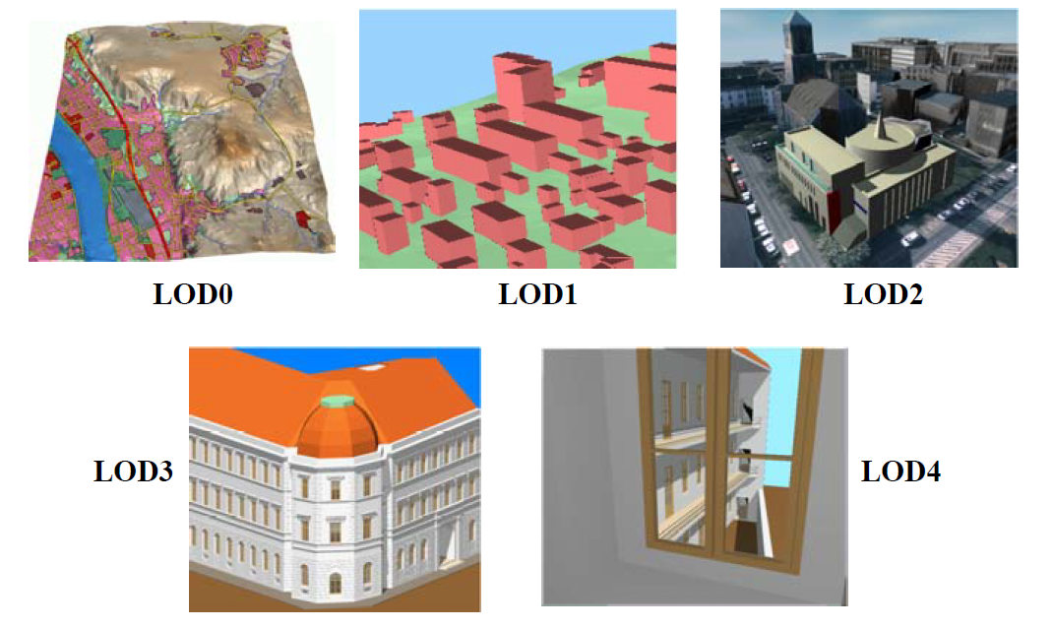
CityGML -- LoDs
CityGML uses five different levels of detail (LoD) to represent the same city model objects in different degrees of detail, where objects become more detailed with the increasing LoD regarding both geometry and thematic differentiation.

Slide 12
Existing Integration Approaches
Most previous integration approaches to a semantic and geometrical integration of IFC and CityGML models have focused mainly on unidirectional conversion from IFC to CityGML, because CityGML is more popular for decision-making.
They define some standard mapping schemas between IFC and CityGML based on the semantic agreement of their interpretation of the same objects.
There are conversion tools which extend CityGML with rich semantic information of IFC.
In addition, commercial software products for conversion from IFC to CityGML make a great effort to the development of 3D city modeling integration.
They recently develop an automatic framework to transform between the IFC building models and CityGML bidirectionally in terms of a conceptual model.
Notes:
highly scalable

Slide 13
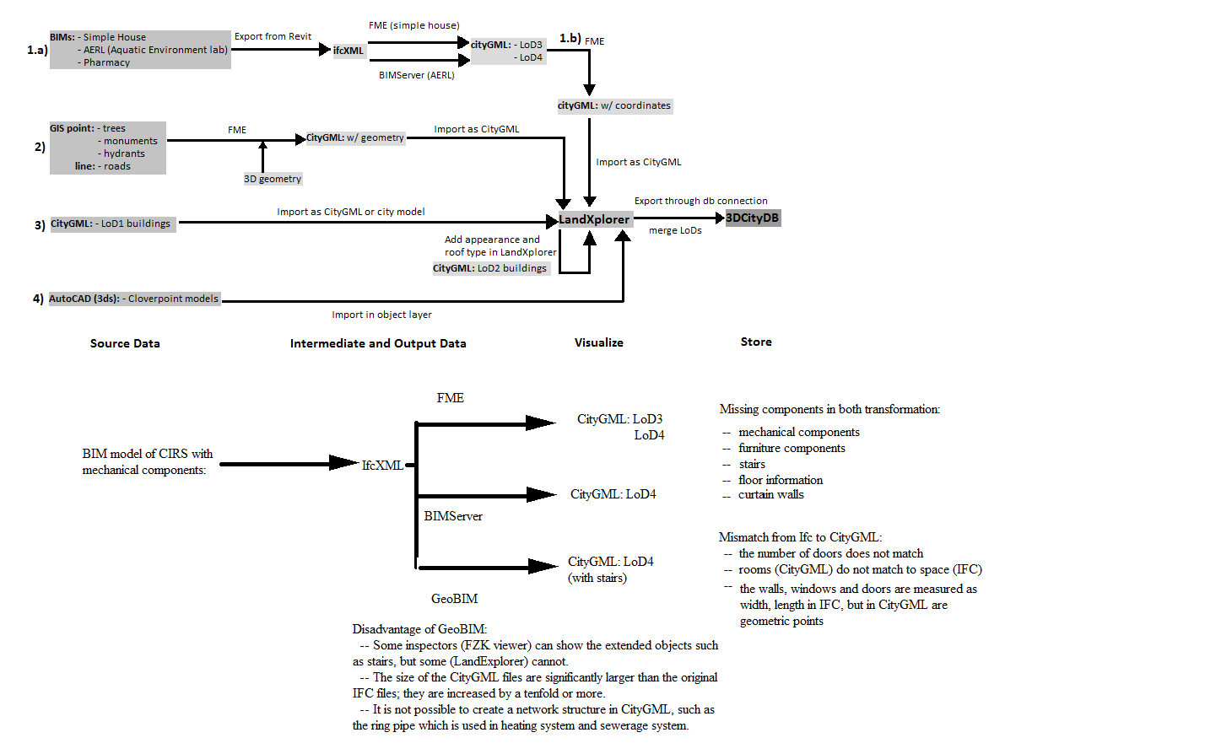
Our approach to transforming IFC to CityGML
Notes:
we chose to build our integration system on top of the existing work. We selected two most suitable frameworks as a start point of our conversion from IFC to CityGML, BIMServer [10] and Feature Manipulation Engine (FME) It is infeasible to convert every necessary component in the BIM into the city model.
The converted files cannot be visualized by the current city model applications.

Slide 14
Data Integration
Instead of loading all the data from separate sources into one central location, in data integration all source data is still stored where it originally is.
A data integration system creates a mediated schema, which represent all the information from all the data sources in the system.
Users query data the mediated schema without knowing the source schemas and then each query over the mediated schema is then translated into queries over the source schemas.

Slide 15
Data Integration
The data warehouse requests to store all the source data in a central data repository, which consumes a large amount of space.
The schema of the data warehouse is well designed and frequent modification of the schema should be avoided.
Data warehouse is more for globalized enterprises, which have very similar schemas, but our project tries to merge two building models which have diverse representations of the same objects.
The data integration system is more flexible in that its mapping language is able to represent the implicit corresponding relations.

Slide 16
Data Integration
The procedure to build a data integration system:
Source schemas
Schema mapping between source schemas
Mediated schema
Mappings between the mediated schema and source schemas
Query rewriting based on the mappings

Slide 17
IFC Schema
The IFC data can be exported into an XML format – ifcXML, which takes advantage of the XML format.
We can locate elements by tags and discover their relationships from its hierarchical structure.
There are many sophisticated tools to extract information from XML files, and, more importantly, we can use XQuery to query information from XML.
In addition, there are several database applications and servers that support reading and writing the ifcXML schema directly into a relational database.

Slide 18
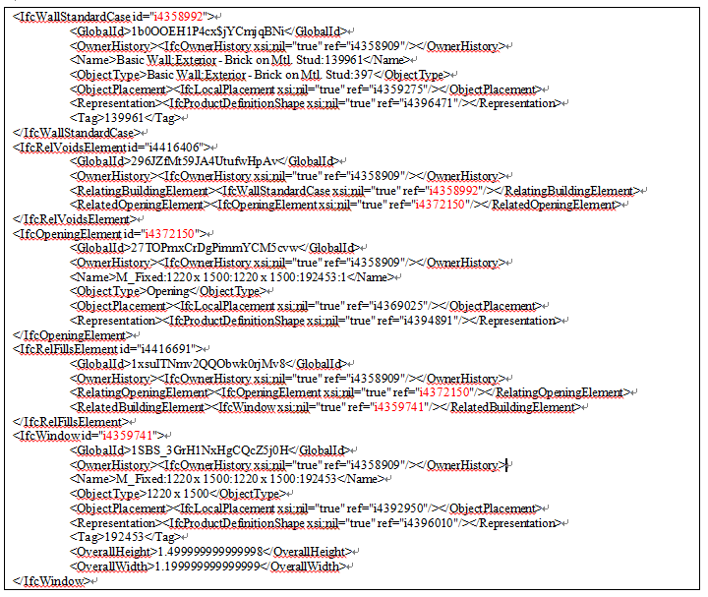
IFC Schema -- ifcXML
Following the reference path through IfcWallStandardCase, IfcRelVoidsElement, IfcOpeningElement, IfcRelFillsElement and IfcWindow by their reference IDs to retrieve the relation of a window on a given wall.

Slide 19
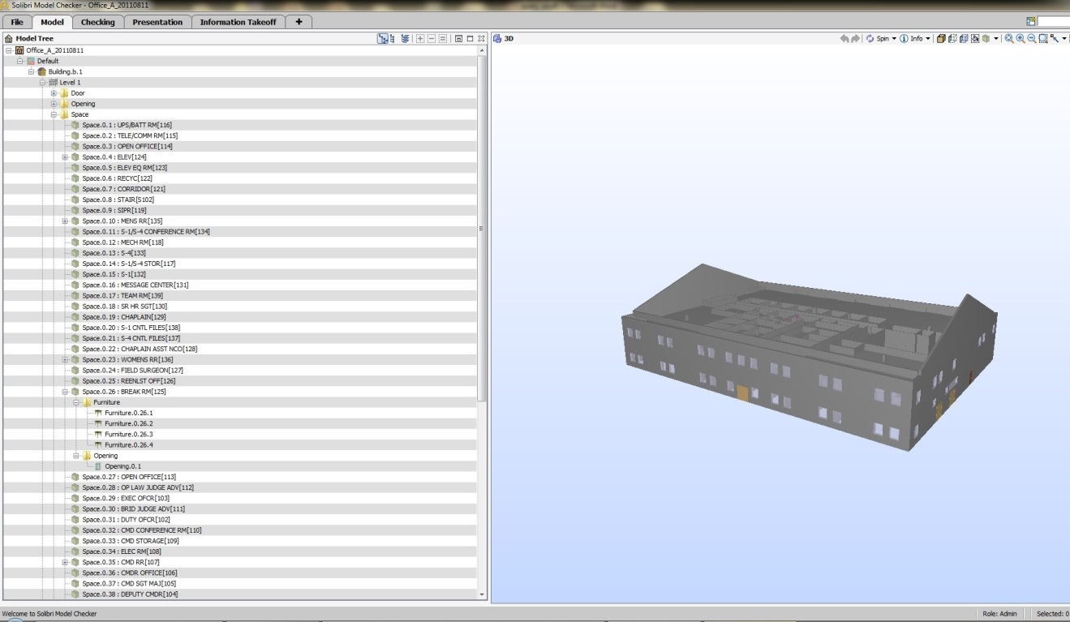
Solibri Model Checker
It provides an easy-to-use visualization interface; the left panel displays all the elements in a building represented in a tree hierarchical structure and the right part demonstrates a complete 3D view of a building.

Slide 20
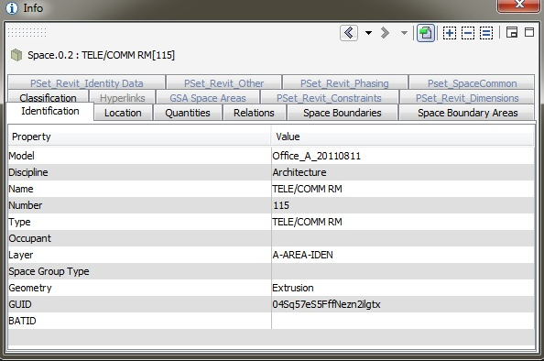
Solibri Model Checker
The IFC schema is generated from Solibri’s attribute sets of each spatial object.
IFC.Space(space_name, number, description, building_name, room_type, floor, area, height, width, length, perimeter, volume, hasWindow, interiorOrExteriorSpace)

Slide 21
CityGML Schema
3D City Database, which is based on a standard spatial relational database system (Oracle Spatial Database) is used to store, represent, and manage virtual 3D city models.
3D City Database is designed to import, export and store spatial data in the format of CityGML by following the CityGML specification/schema.
It supports five different levels of detail of CityGML representation and complex geometric and appearance data.
We use the schema from 3D City Database as our CityGML schema.

Slide 22
The Difference Between Two Schemas
CityGML represents buildings and building components differently, especially with respect to how much detail they show.
Comparing with walls in IFC that are concrete volume objects, in CityGML walls are represented as surfaces, so they are distinguished as interior walls and exterior walls.
Their hierarchical structures of building components are different.

Slide 23
Arithmetic Expressions in Our Mappings
BuildingAddress(BUILDING_NAME, ADDRESSLINES, POSTALBOX, CITY, REGION, POSTALCODE, COUNTRY):-IFC.BuildingAddress(BUILDING_NAME, PURPOSE, DESCRIPTION, ADDRESSLINES, POSTALBOX, CITY, REGION, POSTALCODE, COUNTRY)
BuildingAddress(BUILDING_NAME, HOUSE_NUMBER+" "+STREET, POSTALBOX, CITY, REGION, POSTALCODE, COUNTRY):-CityGML.Address(BUILDING_NAME, STREET, HOUSE_NUMBER, POSTALBOX, POSTALCODE, CITY, REGION, COUNTRY, XAL_SOURCE, MULTIPOINT)
Most of the overlapping attributes are direct semantic mappings, and there is one implicit mapping from ADDRESSLINES to HOUSE_NUMBER+" "+STREET, which indicates that the address line consists of house number and street name.
Notes:
Datalog

Slide 24
Mappings on Geometric Measurements
The length or perimeter of a geometry | SDO_GEOM.SDO_LENGTH
The area of a two-dimensional polygon | SDO_GEOM.SDO_AREA
The maximum value for the specified ordinate (dimension) of the minimum bounding rectangle of a geometry object | SDO_GEOM.SDO_MAX_MBR_ORDINATE
The minimum value for the specified ordinate (dimension) of the minimum bounding rectangle of a geometry object | SDO_GEOM.SDO_MIN_MBR_ORDINATE
The volume of a three-dimensional solid geometry | SDO_GEOM.SDO_VOLUME
Table 1: Geometric functions of measurements from the Oracle Spatial Database
The IFC schema defines the geometric measurements associated with each building element.
However, the geometric information of building components is represented as geometric functions in the CityGML schema.

Slide 25
Contributions of Our Mappings
We focus on the mappings, with regard to their semantic, conceptual, and geometric representations.
We apply the arithmetical and complex mapping expressions to identify their implicit corresponding relationships.
We identify their basic corresponding geometric measurements, for instance, length, height, width, perimeter, and area.
In contrast to the previous mapping results on conceptual level, our mapping result enriches the overlapping information on attributes of the primary building components.
We specify the material and texture information of building components in the mappings.
Since our schema mappings are bidirectional, we are able to flexibly transform data between two models and integrate them together into a comprehensive and rich building representation.

Slide 26
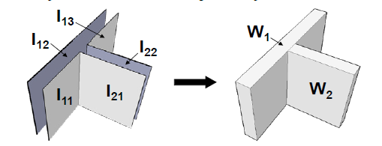
Challenges in Our Mappings
Figure 1: Geometry representation differences between CityGML (left) and IFC (right)
While IFC is a component-based volume model, CityGML applies a boundary representation, an observable surface of topographic features.
More often, multiple objects in the CityGML schema are mapped to a single IFC element. For example, wall surfaces, I₂₁ and I₂₂ are considered as two individual objects in CityGML, which are represented as one solid wall in IFC.
One CityGML object is split into multiple objects in IFC. The exterior wall of a building in CityGML, spanning multiple storeys, is partitioned into one wall per storey in IFC.
Notes:
penetrated The building elements in IFC are grouped by their correspondingly located storeys

Slide 27
Mediated Schema and Query Rewriting
Pottinger and Bernstein’s (PB’s) paper proposed generating the mediated schema from source schemas and overlapping specifications and the query rewriting strategy.
After modifying PB’s algorithms, we generate the mediated schema and the corresponding relationships between the mediated schema and all the source schemas, respectively, with respect to mappings with arithmetic expressions.
After running some queries on our modified algorithms, we demonstrate that the queries posed over the mediated schema will be answered over all the sources and the implicit information is able to be revealed from the source schema.
R. Pottinger and P. A. Bernstein, "Schema merging and mapping creation for relational sources," in Proceedings of the 11th International Conference on Extending Database Technology: Advances in Database Technology, 2008, pp. 73-84.

Slide 28
Mediated Schema and Query Rewriting
Mediated schema:
M.BuildingAddress(building_name,purpose,description,addressLines,postalBox,city,region,postalCode,country,street,house_number,xal_source,multipoint)
Mapping Map_{M_IFC_BuildingAddress}:
Q_IFC_BuildingAddress(building_name,purpose,description,addressLines,postalBox,city,region,postalCode,country):-IFC.BuildingAddress(building_name,purpose,description,addressLines,postalBox,city,region,postalCode,country)
Q_IFC_BuildingAddress(building_name,purpose,description,addressLines,postalBox,city,region,postalCode,country):-M.BuildingAddress(building_name,purpose,description,addressLines,postalBox,city,region,postalCode,country,street,house_number,xal_source,multipoint)
Mapping Map_{M_CityGML_ BuildingAddress}:
Q_CityGML_BuildingAddress(building_name,postalBox,city,region,postalCode,country,street,house_number,xal_source,multipoint,addressLines):- CityGML.Address(building_name,postalBox,city,region,postalCode,country,street, house_number,xal_source,multipoint), addressLines=house_number+" "+street
Q_CityGML_BuildingAddress(building_name,postalBox,city,region,postalCode,country,street,house_number,xal_source,multipoint,addressLines):-M.BuildingAddress(building_name,purpose,description,addressLines,postalBox,city,region, postalCode,country,street,house_number,xal_source,multipoint)
Query on the mediated schema:
q(building_name, addressLines):- M.BuildingAddress(building_name,purpose, description, addressLines,postalBox,city,region,postalCode,country,street,house_number, xal_source,multipoint)
Query rewriting results:
q(building_name, addressLines):- IFC.BuildingAddress(building_name,purpose, description,addressLines,postalBox, city,region,postalCode,country)
q(building_name, addressLines):- CityGML.Address(building_name,postalBox,city, region,postalCode,country,street, house_number,xal_source,multipoint), addressLines=house_number+" "+street

Slide 29
Future Work
Jie’s paper proposes a data integration architecture on the Peer Data Management System, MePSys, to efficiently and automatically maintain and update mediated schemas whenever changes are made to the system. No matter what orders the new sources are added to the system in, the final mediated schema will remain the same.
A spatial query language can be used to identify the spatial structure relationships among building components by analyzing the geometry and topological relationships between objects in the IFC model.
Utility data plays an important role in the maintenance and inspection operations. With the assistance of utility networks between different buildings, maintenance operators can determine the effects on other buildings of shutting down some equipment in a specific building.

Slide 30
Conclusion
Integrating building details into their broader contexts seems a very promising solution to fulfill the management and maintenance requests of the facilities and utilities.
The existing tools cannot convert the highest level of details and the mechanical components in the buildings from IFC model to CityGML.
After comparing data integration systems with data warehouses, we decided to create our data integration architecture.
We defined the IFC and CityGML schemas from their standard schema specifications and the overlapping information using Datalog notation.
We applied complex arithmetic expressions on semantic and geometric representations of building components.
After modifying PB’s algorithms, we rewrote the query posed over the mediated schema to the source schema with respect to mappings with arithmetic expressions and revealed the implicit information from the source schema.

